Slide 1
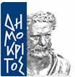
Deep Learning Assignment: Ai in Plasma
NCSR-D
MSc in Artificial Intelligence
Eneri boniakou

Slide 2
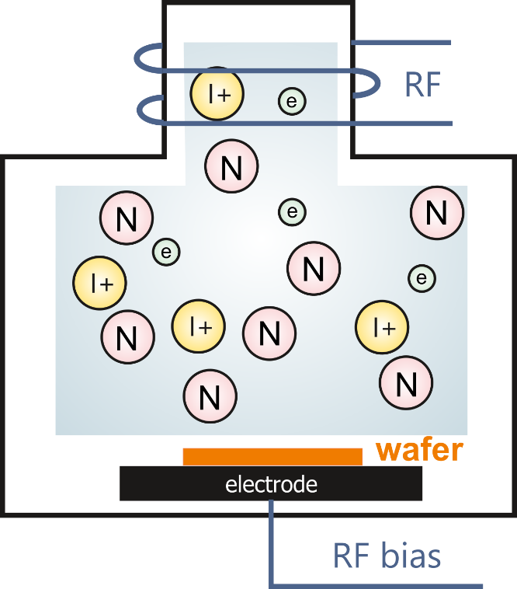
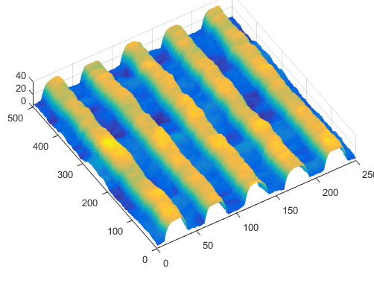
The plasma etching process
Plasma reactor
Etching mask
inlet
sheath
Pattern transfer
sheath
sheath
bulk
sheath
plasmas are used in 35–45% of the steps in microchip manufacturing
outlet
[video]
[www.phietch.com]

Slide 3

Physics Based Modeling
Develop the kinetics
reaction sets for O₂/Ar chemistry
O₂ gas: 156 reactions, 13 species
Ar gas: 40 reactions, 4 species
Search the literature for electron impact cross sections and rate constants
Utilize a global model for the evaluation of the reaction sets (πlasma-R code, www.plasma-r.com)
O₂(b¹S_{g}), O₂(Hz), O₃⁻, O₃⁺
J T Gudmundsson and E G Thorsteinsson, Plasma Sources Sci. Technol. 16 399 (2007).
J. T. Gudmundsson and A. Proto, Plasma Sources Sci. Technol. 28, 045012 (2019). S. Mouchtouris and G. Kokkoris, Plasma Sources Sci. Technol. 25, 025007 (2016).

Slide 4

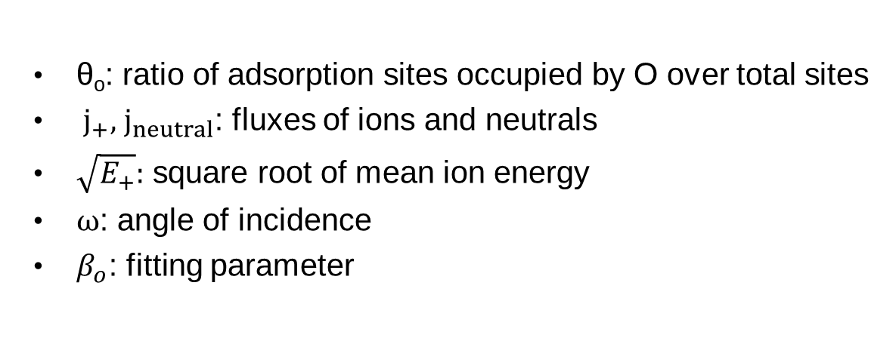

Physics Based Modeling
Develop the kinetics
Surface (etching) kinetics
Ion enhanced etching
$$Etching Rate \left(\frac{μm}{min}\right)=$$
θ_{ο}: ratio of adsorption sites occupied by O over total sites
${ j}_{+},{ j}_{neutral}$: fluxes of ions and neutrals
$\sqrt{E_{+}}:$ square root of mean ion energy
$ω$: angle of incidence
$β_{o}$: fitting parameter
*In this version f(ω) = 1 (no angle dependence)
G. Memos, E. Lidorikis, E. Gogolides and G. Kokkoris, Journal of Physics D: Applied Physics 2021, 54 (17)

Slide 5
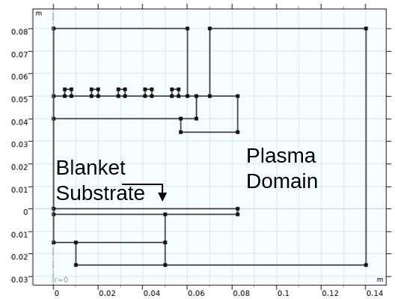
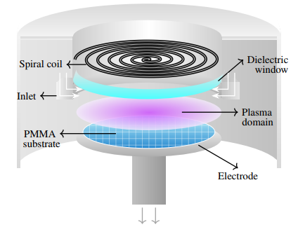
Physics Based Modeling
Develop the detailed 2D reactor scale model
2D axisymmetric geometry
FLUID MODEL
Mass balances for heavy species and electrons, energy balance for electrons, momentum balance, Maxwell’s equations
Spatial distribution of densities
Electron Temperature and Ion mean energy
Etching rate
Outlet Densities
GEC Reactor
Coil Power, pressure
Reactor scale model
Numerical Solution: COMSOL Multiphysics

Slide 6



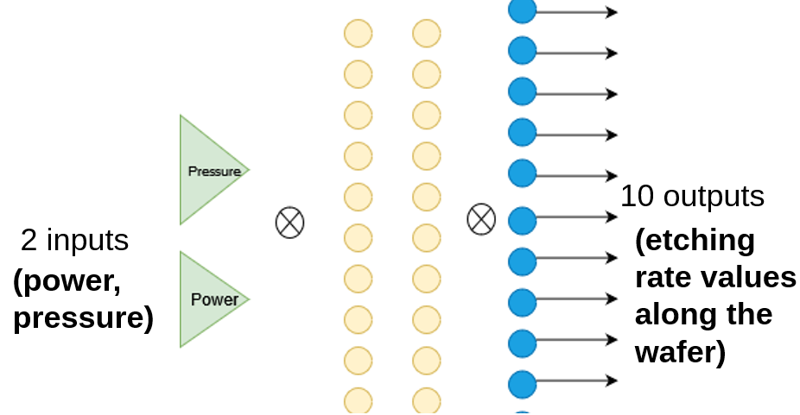
Physics Based Modeling
AI Modeling
Coil Power, pressure
Local etching rate along the wafer
Physics Based Model
Instead of solving PDEs we utilize a neural network
Antenna

Slide 7


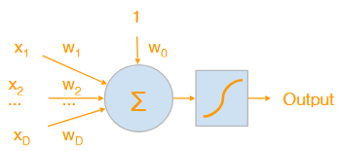
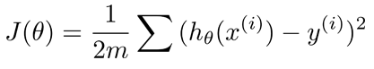



AI Modeling
Train a feedforward neural network using the data acquired from the physics based model
The neural network is a multi-layer perceptron (MLP)
A single perceptron:
$$z=\text{w}\text{∗}\text{x} \text{+ }w_{0}$$
Bias
$$y=a(z)$$
m = # outputs
n = # inputs
z
What we mean by “training” ? In simple words finding the best w matrix that minimizes the loss ground truth and the neural network prediction
= y
Non – linearity/ activation function
J(W) or L(W)
Inputs
Weight
Coil Power, Pressure
node

Slide 8


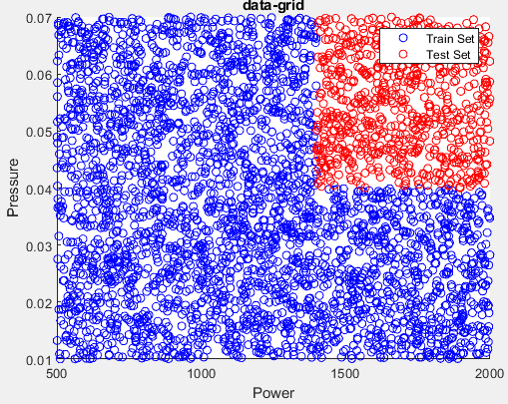
AI Modeling
Iteratively run the 2D reactor scale model
Reactor scale model
Power, Pressure, Etching Rates on 10 points along the wafer
60% of data for training
4000 data points (normalized)
train the NN
20% of data for validation
20% of data for testing
 | Power (Watts) | Pump Pressure (Torr)
O₂ Model | 500-2000 | 0.02-0.07
Ar Model | 50-500 | 0.01-0.06

Slide 9
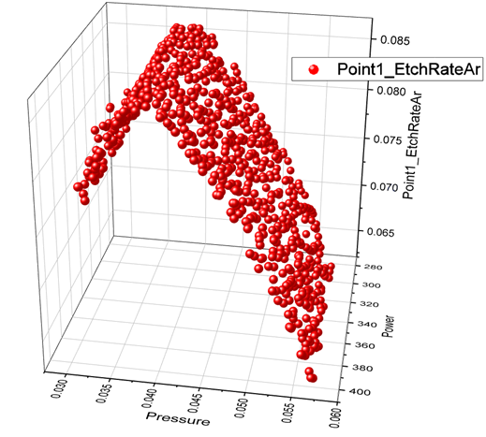
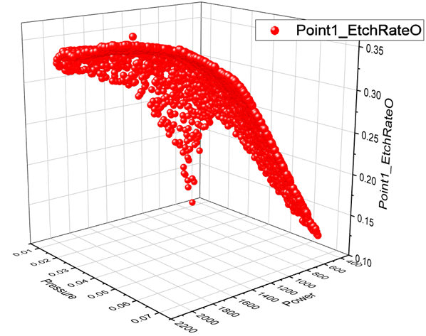
3D Plots of the data – Inputs versus the first output (the etching rate at the center of the PMMA substrate)

Slide 10
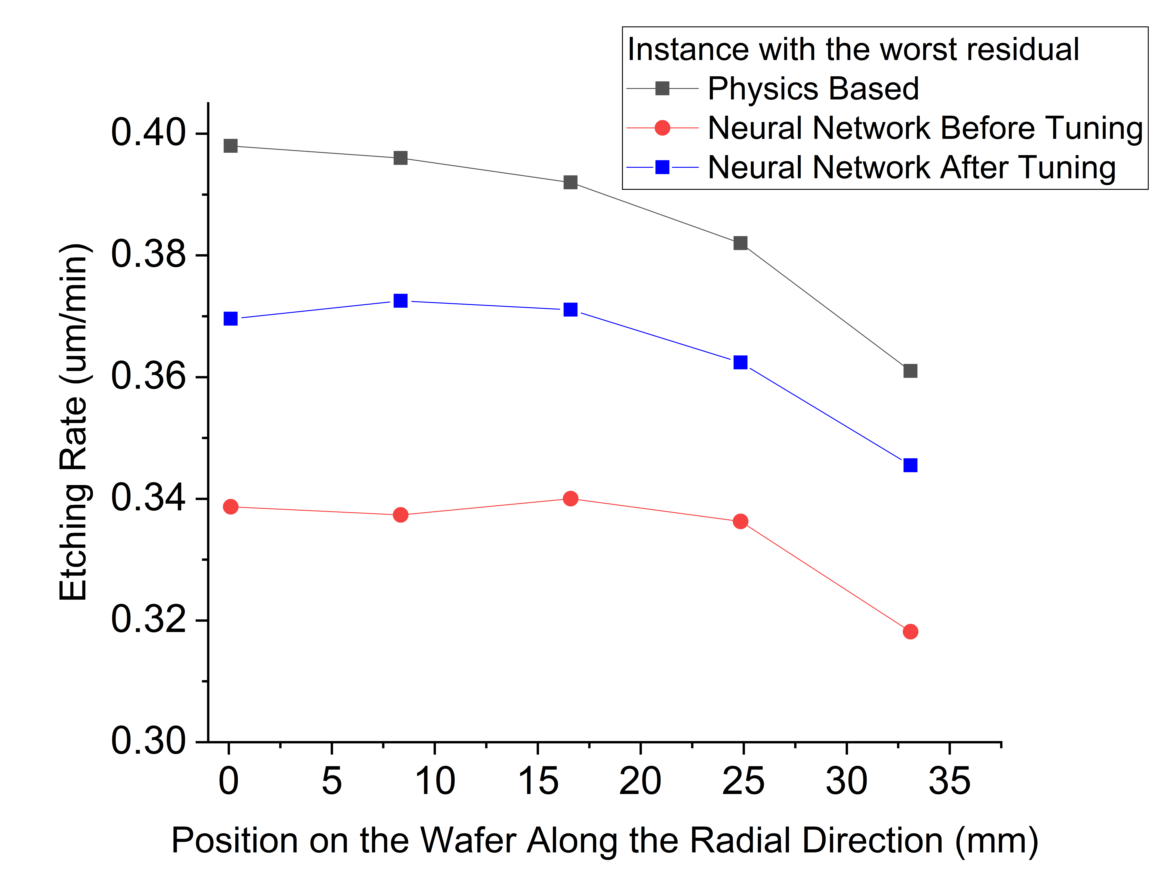
AI Modeling
Neural Network hyperparameter tuning
Batch size (number of training examples used for one update of weights)
Learning rate (how much the model updates the weights)
Neurons per layer (adjust model’s capacity)
Weight decay (penalty to prevent overfitting)
To ensure generalization:
Early stopping
Weight decay
Loss function:
Weighted mean squared error

Slide 11
AI Modeling
Baseline
A simple linear regression !

Slide 12
AI Modeling
Results – MLP (Of course on the test dataset)
Metric | M1 (O₂ model) | M2 (Ar model)
Average MAE | 2.62×10⁻² | 3.43×10⁻⁵
Average R² | 0.4726 | 0.8629
The etching rates of the O2 plasma (M1) are harder to predict than the Ar plasma (M2)…

Slide 13
AI Modeling
Results – MLP vs Baseline
In both models it can be seen that the NN outperforms the simple linear regression…

Slide 14
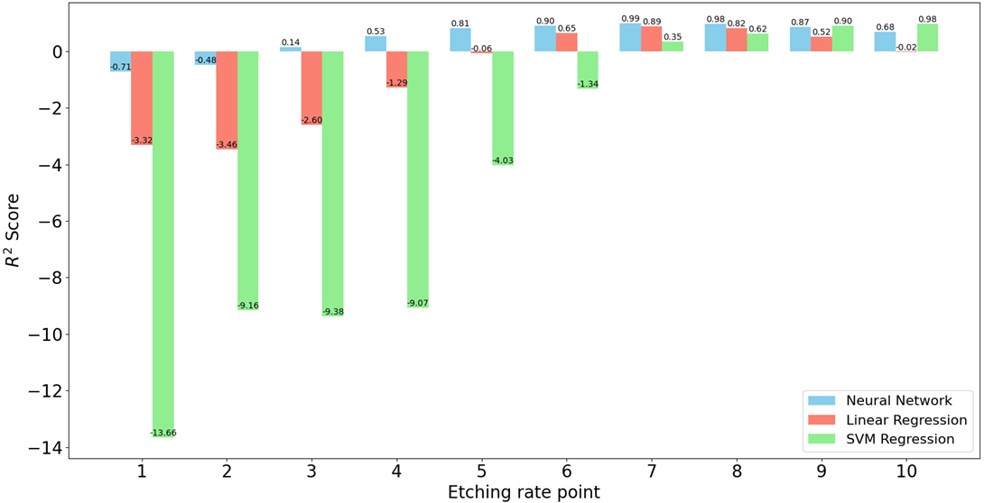
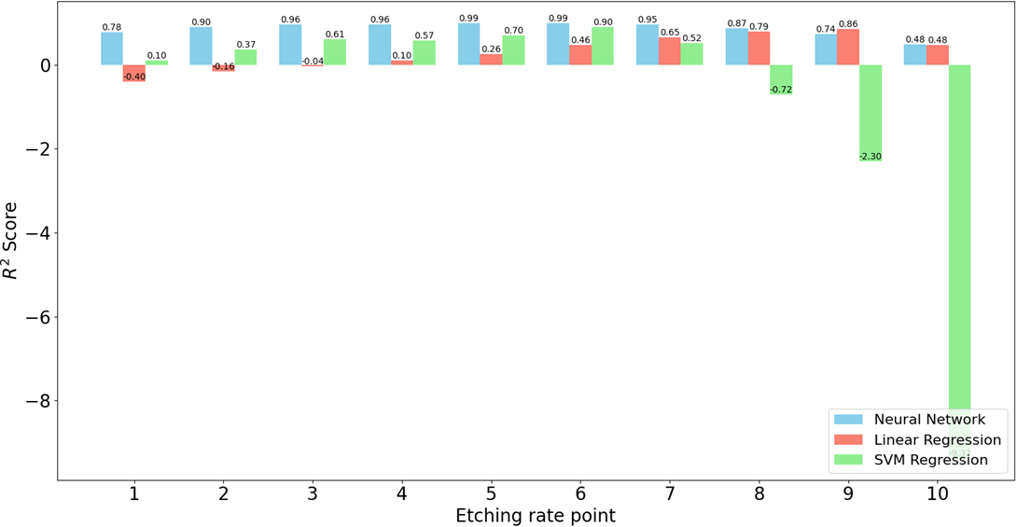
AI Modeling
Results – MLP vs Baseline vs SVR
O₂ plasma – average SVR R² = -4.38
Ar plasma – average SVR R² = -0.861

Slide 15
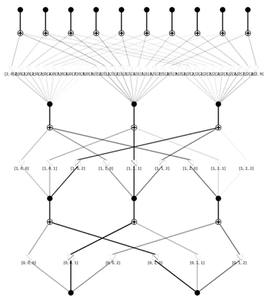
AI Modeling
Implement Kolmogorov – Arnold Networks (KANS)
Metric | M1 (O₂ model) | M2 (Ar model)
Average MAE | 0.00418 | 0.00055
Average R² | 0.77667 | 0.9844
KANs are still function approximators, and our experiments show that they may not learn the true underlying function, but rather an incorrect alternative…
The trained KANs performed comparably to the MLPs but and required a more intensive training regime.

Slide 16
AI Modeling
Implement Kolmogorov – Arnold Networks (KANS)

Slide 17
AI Modeling
Transfer Learning
Note on nomenclature:
M1: O₂ Neural Network
M2: Ar Neural Network
D1: O₂ Dataset
D2: Ar Dataset
M12: M1 trained on D2
M21: M2 trained on D1
A series of experiments were performed, including:
fine-tuning the NN from the first dataset to the second and vice versa
explore catastrophic forgetting
freezing layers
investigate training with a reduced amount of data
Evaluate the model using the opposite test set, as expected poor results:

Slide 18
AI Modeling
Transfer Learning
fine-tuning the NN from the first dataset to the second and vice versa
catastrophic forgetting

Slide 19
AI Modeling
Transfer Learning
freezing layers
When performing the experiments it was observed that the initial layers of the NN adapt to the operating conditions of each case and its governing chemical reaction mechanism, while the deeper layers account for the solution of the PDEs and the surface mechanism, which are simulated similarly in both PBMs.

Slide 20
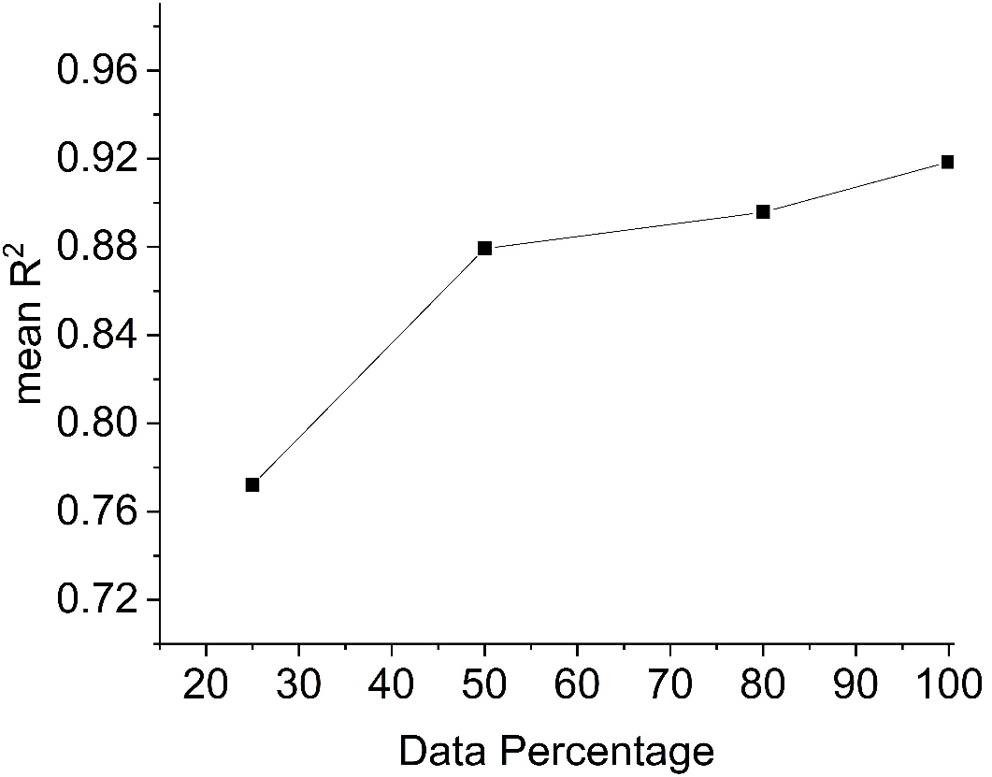
AI Modeling
Transfer Learning
Since M12 performed well, we tested it by cutting down the amount of data
The metrics are calculated by evaluating the NN on the test dataset which remains the same among all experiments.
When cutting down the dataset, the distribution of data remained the same.
The data required to fine-tune the pre-trained neural network from the O2 dataset to the Ar dataset can be reduced by 50% without significantly compromising accuracy and even with less trainable parameters.

Slide 21
Challenges
Goal: Build a pipeline that includes the development of the PBM, the training procedure of the AI model and the knowledge transfer from the pre-trained AI model on one chemistry to another
Simulation development
Data generation
Neural Network architecture and hyperparameters optimization
Exhaustive transfer learning experiments
KANs required almost 6-7 times more training time; using them in transfer learning would be hard…
I could use PINNs, but in the simulation there are solved multiple PDEs and implementing them in the loss function is not straightforward. PINNs may be useful in the future when we will use AI to predict the spatial distributions with coordinates in the reactor

Slide 22

Thank you !

